Slide 1
Java FX programming
Graphical User Interfaces

Slide 2
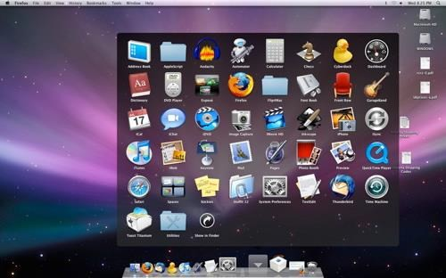
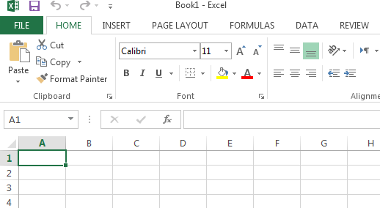
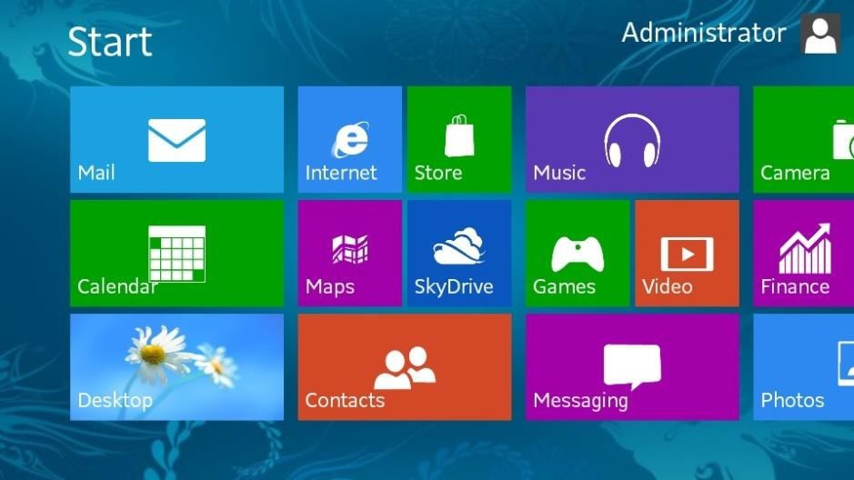
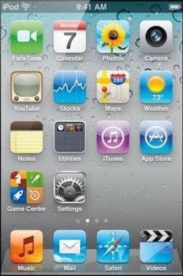
GUI Examples

Slide 3
GUI
Graphical User Interface (GUI)
provides user-friendly human interaction
Building Java GUIs require use of multiple frameworks:
JavaFX (part of JSE 8, 2014)
An old framework would use:
Java’s GUI component Libraries
javax.swing.*
Java’s Event Programming Libraries
java.awt.event.*
Javax.swing.event.*
Java’s Graphics Programming Libraries
java.awt.*
java.awt.geom.*

Slide 4
JavaFX vs Swing and AWT
Swing and AWT are replaced by the JavaFX platform for developing rich Internet applications in JDK8.
When Java was introduced, the GUI classes were bundled in a library known as the
Abstract Windows Toolkit (AWT).
AWT is fine for developing simple graphical user interfaces, but not for developing comprehensive GUI projects.
In addition, AWT is prone to platform-specific bugs.
The AWT user-interface components were replaced by a more robust, versatile, and
flexible library known as Swing components.
Swing components are painted directly on canvases using Java code.
Swing components depend less on the target platform and use less of the native GUI resource.
With the release of Java 8, Swing is replaced by a completely new GUI platform: JavaFX.

Slide 5
Example: a mouse click on a button
Operating System recognizes mouse click
determines which window it was inside
notifies that program
Program runs in loop
checks input buffer filled by OS
if it finds a mouse click:
determines which component in the program
if the click was on a relevant component
respond appropriately according to handler

Slide 6
How do GUIs work?
Construct GUI Components
Render GUI
They loop and respond to events
Check to see if any input
Respond to user input

Slide 7
GUI Look vs. Behavior
Look
physical appearance
custom component design
containment
layout management
Behavior
interactivity
event programmed response

Slide 8
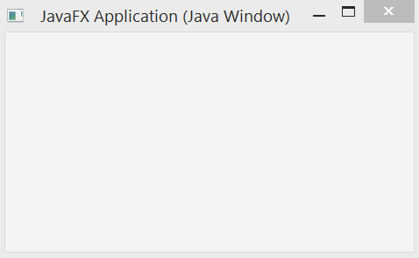
What does a GUI framework do for you?
Provides ready made visible, interactive, customizable components
you wouldn’t want to have to code your own window

Slide 9
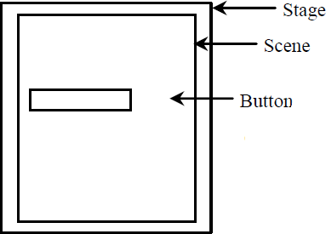
Basic Structure of JavaFX
javafx.application.Application is the entry point for JavaFX applications
JavaFX creates an application thread for running the application start method, processing input events, and running animation timelines.
Override the start(Stage) method!
javafx.stage.Stage is the top level JavaFX container.
The primary Stage is constructed by the platform.
javafx.scene.Scene class is the container for all content in a scene graph.
javafx.scene.Node is the base class for scene graph nodes.

Slide 10
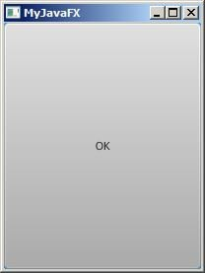
My first JavaFX App
import javafx.application.Application; import javafx.stage.Stage;
import javafx.scene.Scene;
import javafx.scene.control.Button;
public class MyFirstJavaFX extends Application
{
@Override // Override the start method in the Application class public void start(Stage primaryStage) {
// Create a button and place it in the scene Button btOK = new Button("OK");
Scene scene = new Scene(btOK, 200, 250); primaryStage.setTitle("MyJavaFX"); // Set the stage title primaryStage.setScene(scene); // Place the scene in the stage primaryStage.show(); // Display the stage
}
/**
The main method is only needed for the IDE with limited
JavaFX support. Not needed for running from the command line.
*/
public static void main(String[] args) { launch(args);
}
}

Slide 11
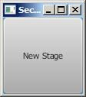
My second JavaFX App
// Multiple stages can be added beside the primaryStage import javafx.application.Application;
import javafx.stage.Stage; import javafx.scene.Scene;
import javafx.scene.control.Button;
public class MultipleStageDemo extends Application {
@Override // Override the start method in the Application class
public void start(Stage primaryStage) {
// Create a scene and place a button in the scene Scene scene = new Scene(new Button("OK"), 200, 250);
primaryStage.setTitle("MyJavaFX"); // Set the stage title primaryStage.setScene(scene); // Place the scene in the stage primaryStage.show(); // Display the stage
Stage stage = new Stage(); // Create a new stage stage.setTitle("Second Stage"); // Set the stage title
// Set a scene with a button in the stage
stage.setScene(new Scene(new Button("New Stage"), 100, 100)); stage.show(); // Display the stage
}
public static void main(String[] args) { launch(args);
}
}

Slide 12
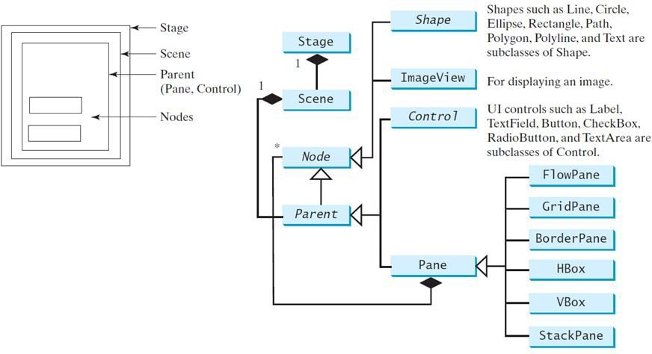
Panes, UI Controls, and Shapes

Slide 13

import javafx.application.Application;
Pane
import javafx.stage.Stage; import javafx.scene.Scene;
import javafx.scene.layout.StackPane; import javafx.scene.control.Button;
public class ButtonInPane extends Application
{
@Override // Override the start method in the Application class public void start(Stage primaryStage) {
// Create a scene and place a button in the scene StackPane pane = new StackPane(); pane.getChildren().add(new Button("OK")); Scene scene = new Scene(pane, 200, 50); primaryStage.setTitle("Button in a pane");
// Set the stage title
primaryStage.setScene(scene); // Place the scene in the stage primaryStage.show(); // Display the stage
}
public static void main(String[] args) { launch(args); }
}

Slide 14
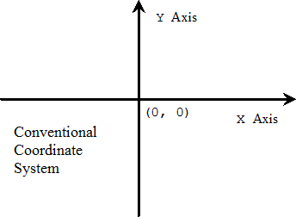
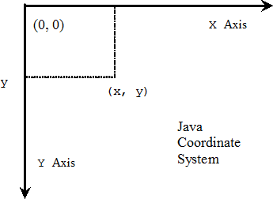
Display a Shape
Programming Coordinate Systems start from the left-upper corner

Slide 15
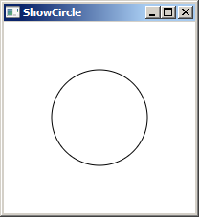
import javafx.stage.Stage; import javafx.scene.Scene; import javafx.scene.layout.Pane; import javafx.scene.shape.Circle; import javafx.scene.paint.Color;
import javafx.application.Application;
Circle
public class ShowCircle extends Application {
@Override // Override the start method in the Application class
public void start(Stage primaryStage) {
// Create a circle and set its properties Circle circle = new Circle(); circle.setCenterX(100); circle.setCenterY(100); circle.setRadius(50); circle.setStroke(Color.BLACK); circle.setFill(null);
// Create a pane to hold the circle Pane pane = new Pane(); pane.getChildren().add(circle);
// Create a scene and place it in the stage Scene scene = new Scene(pane, 200, 200);
primaryStage.setTitle("ShowCircle"); // Set the stage title primaryStage.setScene(scene); // Place the scene in the stage primaryStage.show(); // Display the stage
}
/** * The main method is only needed for the IDE with limited
* JavaFX support. Not needed for running from the command line.
*/
public static void main(String[] args) { launch(args); }
}

